Slide 1

Breast cancer prediction
Charishma Pavuluri ID: 00795134
Sarikareddy Seelam ID:00787168

Slide 2
Introduction
The significance of early detection in breast cancer cannot be overstated. Timely identification allows for more effective treatment and significantly improves patient outcomes.
The objective is to develop and compare machine learning models for breast cancer prediction. The primary aim is to identify the most effective and robust model for early breast cancer detection.
Utilizing logistic regression as a baseline, the project explores the effectiveness of advanced models, including XGBoost, Random Forest, and Convolutional Neural Network (CNN) in breast cancer prediction.

Slide 3
Importing Required Libraries
Data Handling Libraries laid the foundation for successful analysis and model development.
Visualization Libraries empowered us to create clear and informative visual representations, aiding in the exploration, interpretation, and communication of patterns and insights within the data.
Preprocessing and Feature Selection Libraries enabled the transformation of raw data into a format suitable for modeling, improving model performance by selecting the most relevant features and enhancing interpretability.
Machine Learning Model Libraries facilitated development of accurate and robust classification models

Slide 4

Data Description
The dataset used was collected from Kaggle with the dataset link; https://www.kaggle.com/datasets/imtkaggleteam/breast-cancer/
It had 569 rows and 33 columns
The target attribute in the dataset was diagnosis

Slide 5

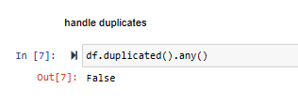
Data preprocessing
Data preprocessing involved handling missing values, duplicates, outliers and data encoding
Only one column was found to have missing values, this column was dropped because all its entries had missing values and the dataset was now clean with no missing values
Duplicates were checked and the dataset was found to have none

Slide 6
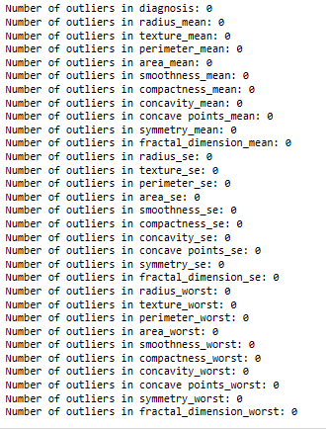
A good number of columns were found to have outliers.
The identified outliers were capped and the resulting dataframe had none
All the categorical attributed were encoded using Label encoder to prepare the attributes for the machine learning models

Slide 7
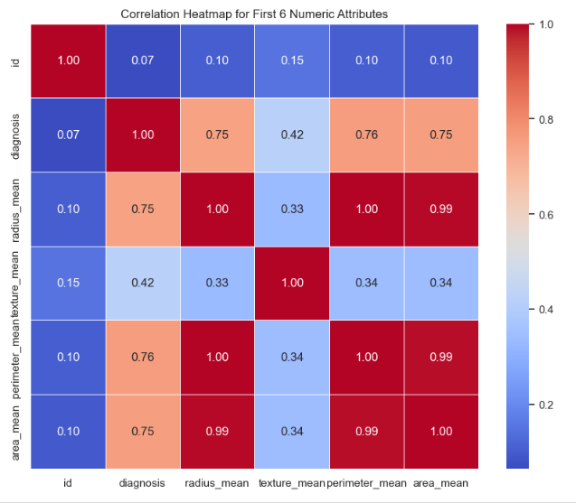
Exploratory Data Analysis (EDA)
Statistical description provided a comprehensive overview of the dataset's key metrics for various breast cancer features, including count, mean, standard deviation, minimum, 25th percentile, median (50th percentile), 75th percentile, and maximum values.
Strong positive correlations between 'radius_mean' and 'area_mean' (0.997692), indicated a high degree of linear association. Conversely, weak correlations between 'id' and 'diagnosis' (0.065270), suggested a limited linear relationship.

Slide 8
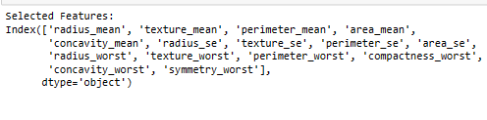
Feature Selection
RFE was used to select n best preforming features
The selected features were as shown in the figure

Slide 9
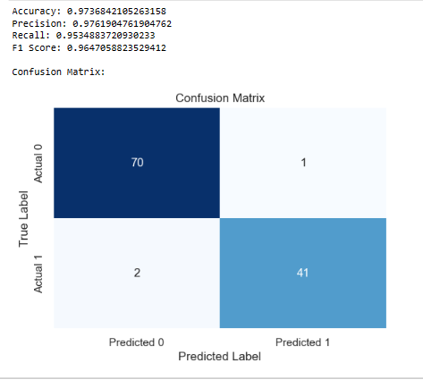
Baseline (Logistic Regression) Model
Data was split into training and test sets, with test size of 20% and random state of 42.
Logistic regression model was trained and tested using training and test sets.
It achieved an excellent accuracy of 0.97, precision of 0.976, recall of 0.95, and F1 score of 0.96

Slide 10
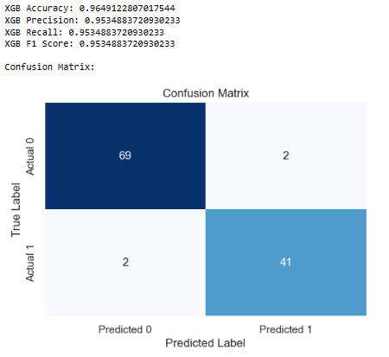
XGBoost Model
XGBoost model was trained and tested using training and test sets.
It achieved an excellent accuracy of 0.96, precision of 0.95, recall of 0.95, and F1 score of 0.95

Slide 11
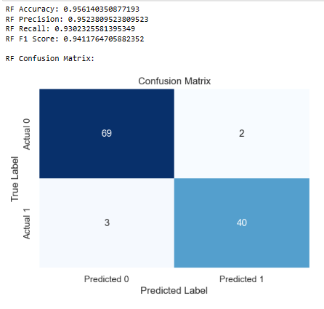
Random Forest Classifier Model
Random Forest Classifier model was trained and tested using training and test sets.
It achieved an excellent accuracy of 0.956, precision of 0.95, recall of 0.93, and F1 score of 0.94

Slide 12
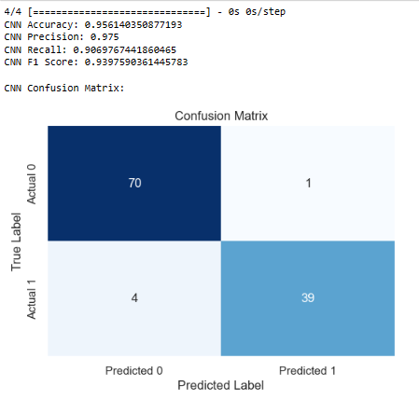
CNN Model
CNN model was trained and tested using training and test sets.
It achieved an excellent accuracy of 0.956, precision of 0.975, recall of 0.907, and F1 score of 0.94

Slide 13
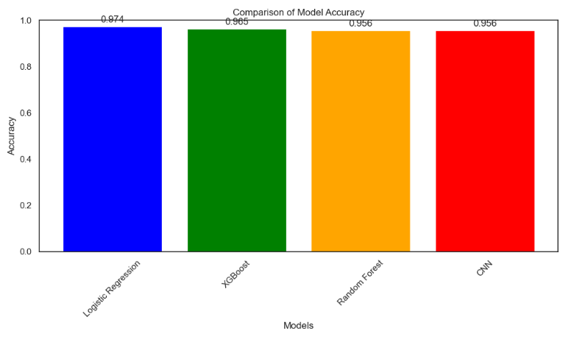
Model Comparison
Baseline (Logistic regression) model outperformed all the models with an accuracy of 0.974.
Although CNN and Random forest classifier performed excellently well, they were among the least performing models

Slide 14
Thank You

